Slide 1
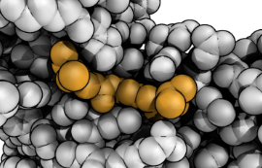




Scaling Virtual Screening to Ultra-Large Virtual Chemical Libraries
OSG School Showcase
June 25, 2025
Spencer S. Ericksen
UW Carbone Cancer Center
Drug Development Core
Small Molecule Screening Facility
ssericksen@wisc.edu

Slide 2
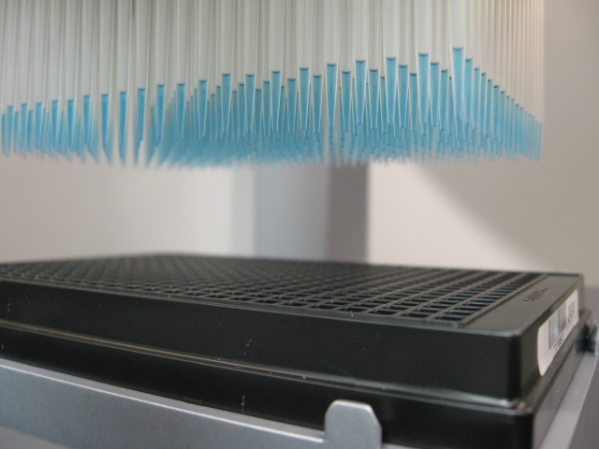
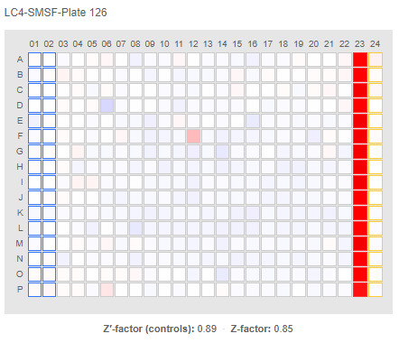
Early-stage drug discovery
Find rare molecules that affect a specific biological process. Develop as probes or drug candidates.
Early-stage drug discovery is a needle-in-the-haystack problem—could be 10³³ drug-like organic molecules.*
High-Throughput Screening (HTS) is too expensive.
*Polishchuk PG, et al., JCAMD 2013 27(8):675-9
Notes:
Assay costs: $0.10-$1.00 per well – average $0.40.
Compound costs: range: $10-$100 (non-bulk) and $1-$2 (bulk) – avg $30.00 compound (non-bulk)
Screen 10,000 -> $15k + $4k = $19k
Screen 50,000 -> $75k + $20k = $95k

Slide 3
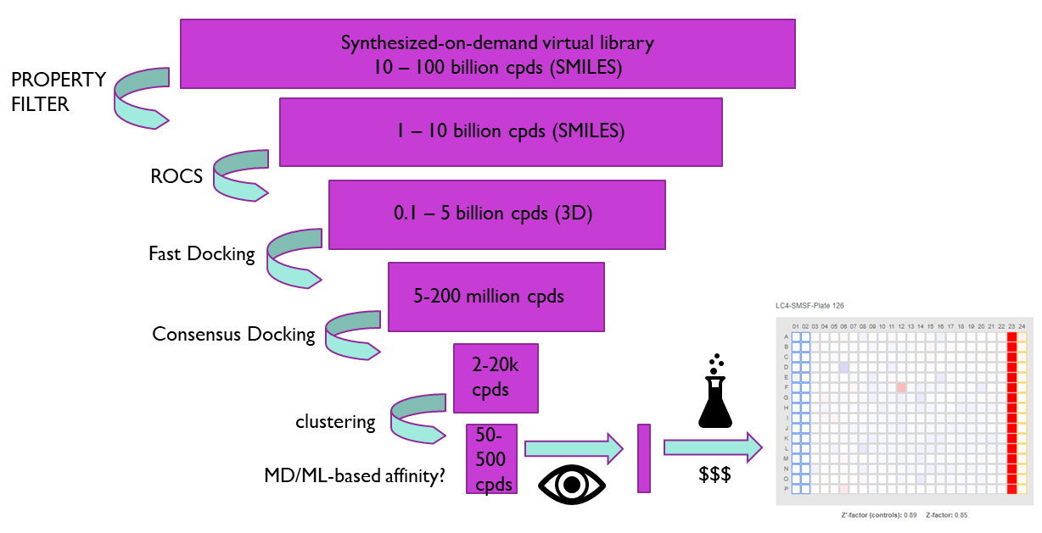
What is Virtual Screening?
Virtual Screening: use a computer model to predict “active” molecules within large molecule sets.
Structure-Based VS uses physics-based (or AI) model to predict whether molecule will bind target protein
Ligand-Based VS uses supervised ML model to relate molecule structure to a property.
Goal: reduce number of molecules that must be tested
Notes:
Assay costs: $0.10-$1.00 per well – average $0.40.
Compound costs: range: $10-$100 (non-bulk) and $1-$2 (bulk) – avg $30.00 compound (non-bulk)
Screen 10,000 -> $15k + $4k = $19k
Screen 50,000 -> $75k + $20k = $95k

Slide 4
HTS vs VS
Real Screening (HTS)
Virtual Screening + Real Focused Screening
test 10⁴-10⁶ cpds
generates valuable real data
expensive
noisy
can’t scale to ultra-large libraries
assay must scale to 10⁴-10⁶
VS 10⁸-10¹² → test 10²-10⁴ cpds
limited real data generation
cheap
VERY noisy
scales to ultra-large libraries (10⁹-10¹²)
VS models have data requirements

Slide 5
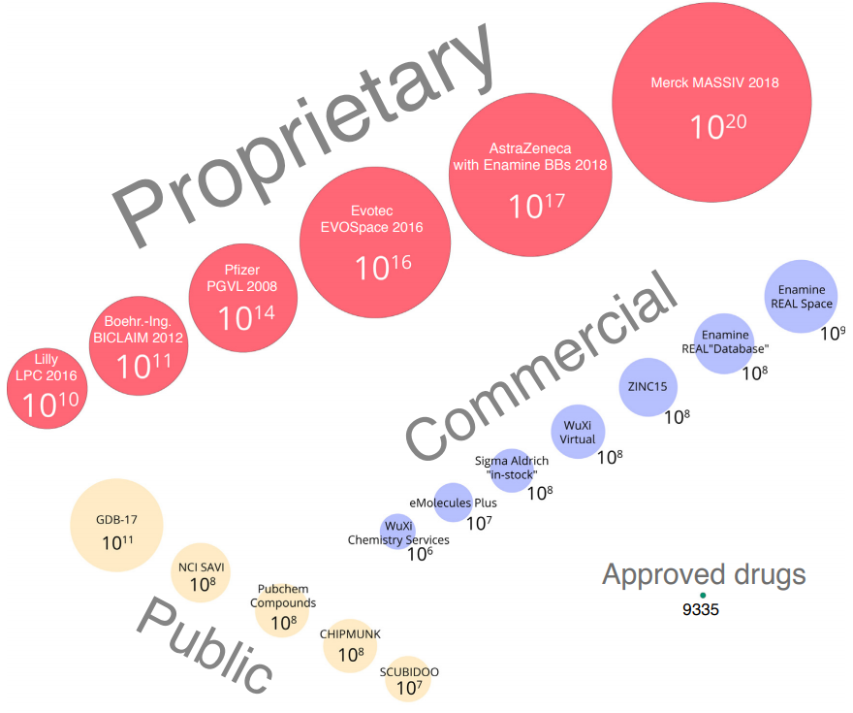
Size Comparison of Virtual and Physical Chemical Libraries
Hoffmann & Gastreich “The next level in chemical space navigation: going far beyond enumerable compound libraries.” Drug Discovery Today, 2019, 24, 5, 1148-1156.
Walters P. “Virtual Chemical Libraries.” J. Med. Chem. 2019, 62, 3, 1116-1124

Slide 6

SBVS
Structure-based virtual screening

Slide 7
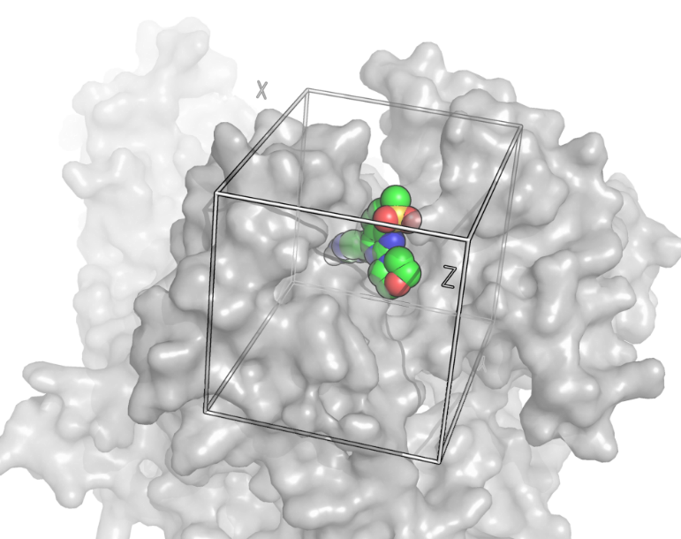
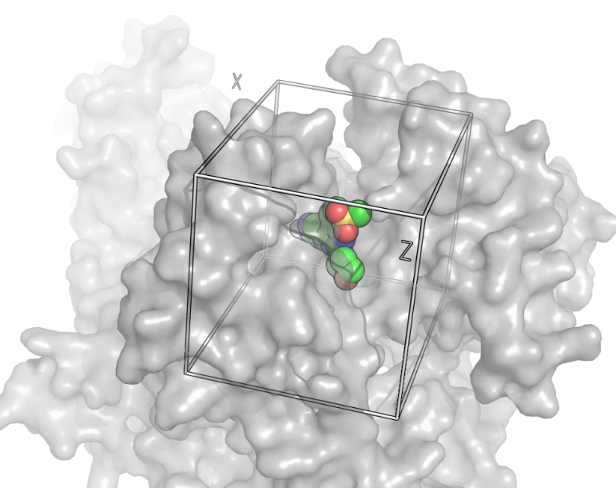
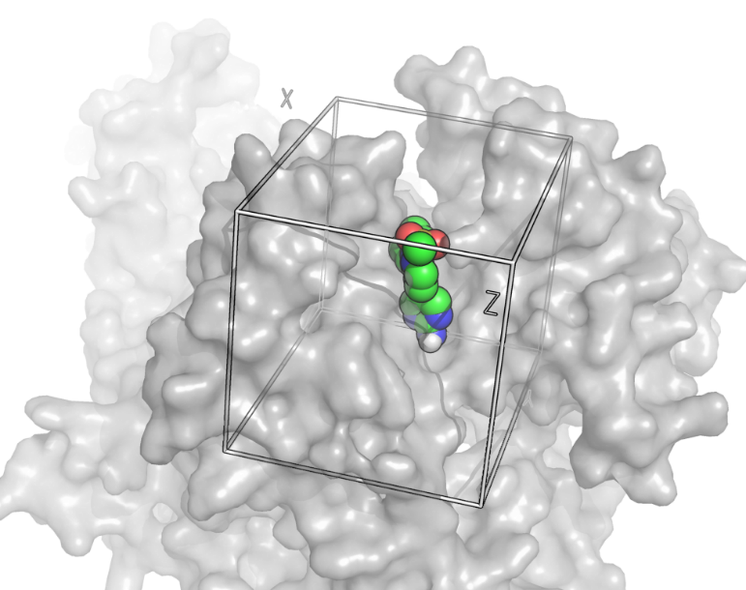
What is docking?
Docking uses 3D molecular models to find best fit of molecule to active site of target.
Search guided by a scoring function that evaluates favorability of each sampled configuration.
Many docking programs are available.
Docking score is crude estimate of binding favorability for a given compound.
Notes:
Average ~1 minute per docking.

Slide 8
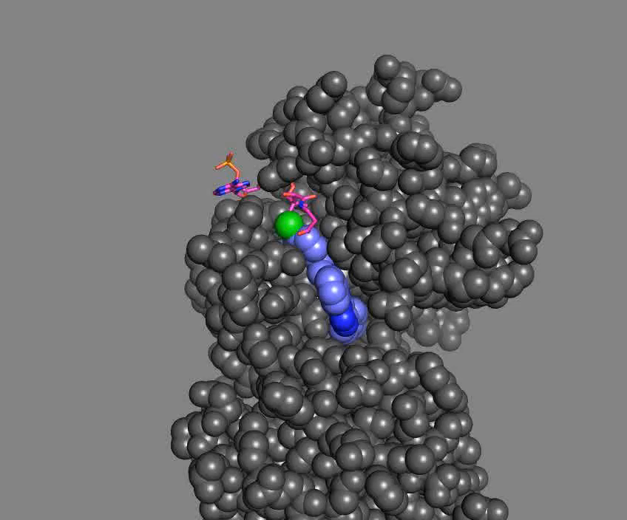
Structure-based virtual screening
MOLID |  | SCORE
ZINC36206438 |  | 58.63
ZINC59310217 |  | 58.72
ZINC61596674 |  | 56.35
ZINC67458535 |  | 47.40
CHEMBL1221861 |  | 60.66
ZINC10123401 |  | 52.39
ZINC64526095 |  | 66.13
ZINC24002103 |  | 56.72
ZINC09612655 |  | 58.84
ZINC24002105 |  | 38.95
CHEMBL38532 |  | 74.19
ZINC40824467 |  | 50.10
ZINC59829723 |  | 58.29
ZINC37520295 |  | 44.78
ZINC49812309 |  | 38.01
ZINC14558020 |  | 53.31
CHEMBL472090 |  | 58.71
ZINC36207525 |  | 69.07
ZINC14010625 |  | 68.48
CHEMBL274782 |  | 63.97
ZINC63949457 |  | 55.35
ZINC39657146 |  | 48.74
ZINC23197109 |  | 58.72
ZINC25520953 |  | 63.14
ZINC09282496 |  | 43.71
ZINC60343267 |  | 62.18
ZINC58790750 |  | 62.53
CHEMBL400392 |  | 65.96
ZINC52096905 |  | 49.96
ZINC48922871 |  | 49.59
ZINC33058380 |  | 45.11
ZINC64684798 |  | 56.64
ZINC21076300 |  | 68.36
ZINC29461868 |  | 50.65
CHEMBL26183 |  | 58.56
ZINC61908006 |  | 66.40
ZINC15429053 |  | 54.10
CHEMBL323258 |  | 74.94
ZINC05091951 |  | 58.47
ZINC02759924 |  | 48.25
ZINC54596097 |  | 42.68
ZINC19899314 |  | 65.54
ZINC53113244 |  | 38.99
ZINC40947055 |  | 61.87
ZINC36611787 |  | 60.04
CHEMBL419085 |  | 65.96
ZINC35844701 |  | 58.57
ZINC01296699 |  | 39.07
ZINC39914438 |  | 49.68
ZINC00706129 |  | 48.34
ZINC34747432 |  | 52.55
ZINC43220997 |  | 47.45
ZINC37619890 |  | 54.49
ZINC15666896 |  | 55.50
MOLID |  | SCORE
CHEMBL323258 |  | 74.94
CHEMBL38532 |  | 74.19
ZINC36207525 |  | 69.07
ZINC14010625 |  | 68.48
ZINC21076300 |  | 68.36
ZINC61908006 |  | 66.40
ZINC64526095 |  | 66.13
CHEMBL419085 |  | 65.96
CHEMBL400392 |  | 65.96
ZINC19899314 |  | 65.54
CHEMBL274782 |  | 63.97
ZINC25520953 |  | 63.14
ZINC58790750 |  | 62.53
ZINC60343267 |  | 62.18
ZINC40947055 |  | 61.87
CHEMBL1221861 |  | 60.66
ZINC36611787 |  | 60.04
ZINC09612655 |  | 58.84
ZINC59310217 |  | 58.72
ZINC23197109 |  | 58.72
CHEMBL472090 |  | 58.71
ZINC36206438 |  | 58.63
ZINC35844701 |  | 58.57
CHEMBL26183 |  | 58.56
ZINC05091951 |  | 58.47
ZINC59829723 |  | 58.29
ZINC24002103 |  | 56.72
ZINC64684798 |  | 56.64
ZINC61596674 |  | 56.35
ZINC15666896 |  | 55.50
ZINC63949457 |  | 55.35
ZINC37619890 |  | 54.49
ZINC15429053 |  | 54.10
ZINC14558020 |  | 53.31
ZINC34747432 |  | 52.55
ZINC10123401 |  | 52.39
ZINC29461868 |  | 50.65
ZINC40824467 |  | 50.10
ZINC52096905 |  | 49.96
ZINC39914438 |  | 49.68
ZINC48922871 |  | 49.59
ZINC39657146 |  | 48.74
ZINC00706129 |  | 48.34
ZINC02759924 |  | 48.25
ZINC43220997 |  | 47.45
ZINC67458535 |  | 47.40
ZINC33058380 |  | 45.11
ZINC37520295 |  | 44.78
ZINC09282496 |  | 43.71
ZINC54596097 |  | 42.68
ZINC01296699 |  | 39.07
ZINC53113244 |  | 38.99
ZINC24002105 |  | 38.95
ZINC49812309 |  | 38.01
Dock Compound Library
Score Distributions
Sort Compounds by Docking Scores
Inactives
Number of
Compounds
Actives
Scores

Slide 9
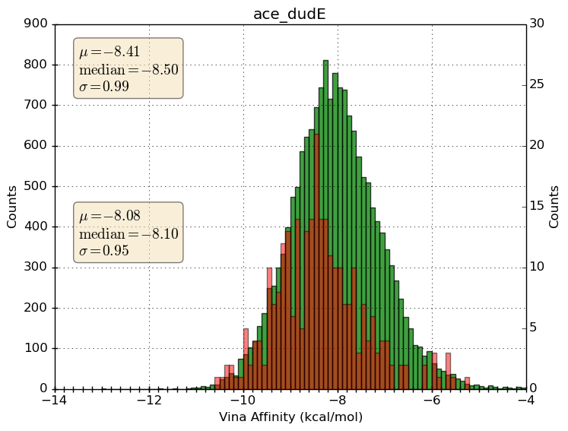
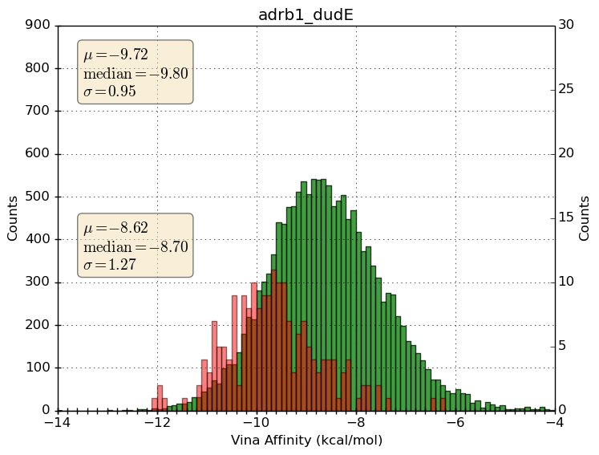
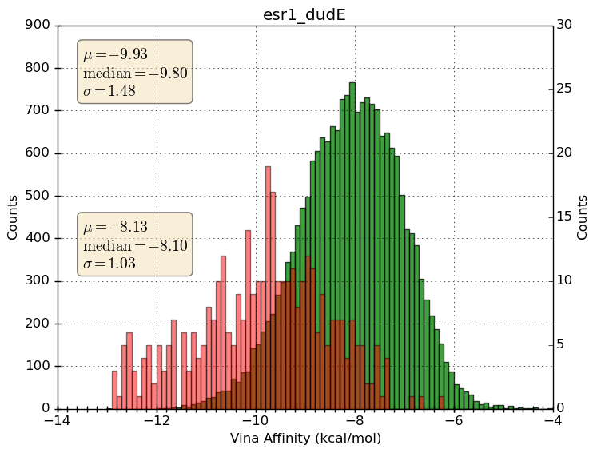
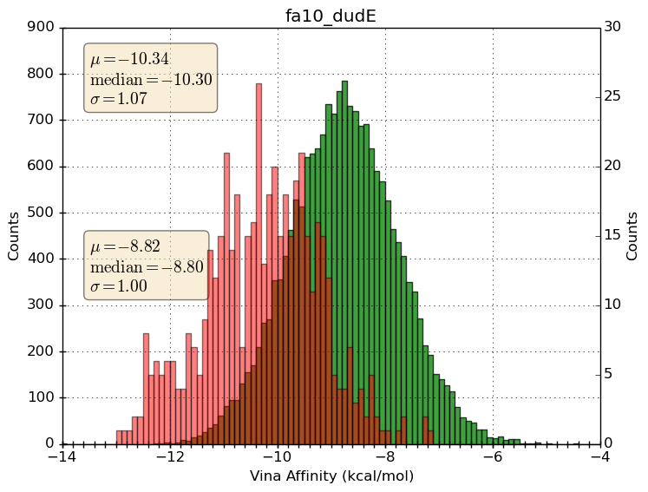
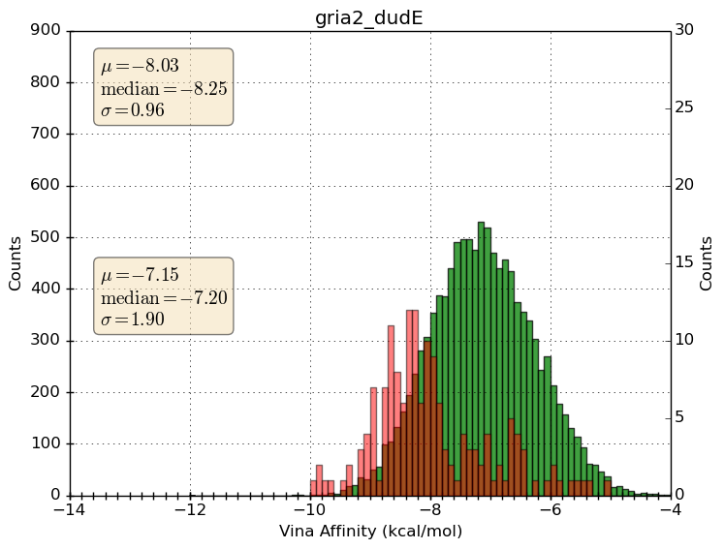
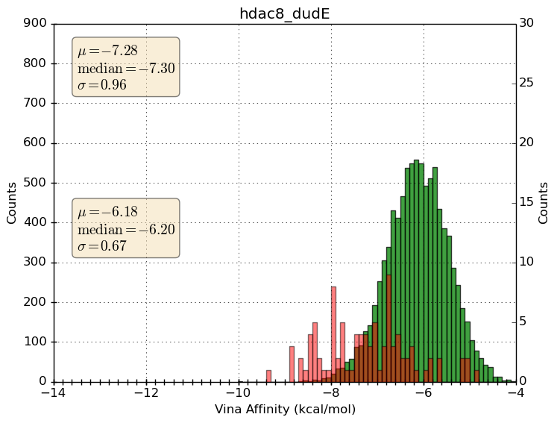
Examples of SBVS performance using docking program Vina on 6 benchmark targets from DUD-E
http://dude.docking.org/
Red = score distribution for known actives
Green = score distribution for decoys (presumed inactives)
decoy
active
Notes:
6 targets from the DUD-E set of targets:
# Vina performance
TARG ROC_AUC BEDROC_AUC BEDROC ERF1 ERF0.25
ace 0.612 0.0912 0.107
adrb1 0.771 0.187 0.212 2.56 8.98
esr1 0.856 0.400 0.481 22.4
fa10 0.851 0.347 0.444 16.3
gria2 0.761 0.247 0.282 6.99
hdac8 0.828 0.421 0.464 29.6

Slide 10

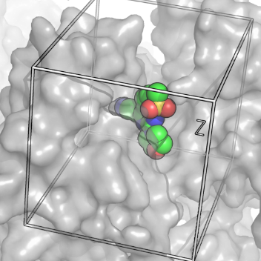
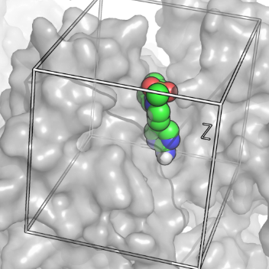

Consensus Scoring
No single program is reliable
Use multiple docking programs
Consensus scores are more reliable than those from any individual docking program.
Dock6
Inactives
AutoDock4
Consensus Model
Actives
Scores
FRED
(developed in collaboration with Newton Lab)
Surflex
.
.
.
Ericksen et al., J. Chem. Inf. Model. 2017, 57, 7, 1579-1590 DOI: 10.1021/acs.jcim.7b00153

Slide 11
21 DUD-E Benchmark Targets
Score distribution of actives (red) is shifted relative to inactives (blue).
Interestingly, the standard deviation in scores was also higher for actives than for decoys. We leverage in MVC consensus scoring model (developed in Newton lab).
Ericksen et al., J. Chem. Inf. Model. 2017, 57, 7, 1579-1590 DOI: 10.1021/acs.jcim.7b00153

Slide 12
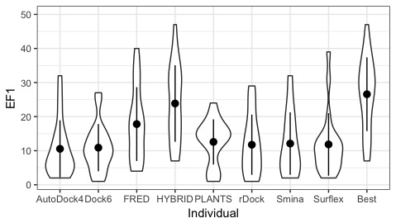
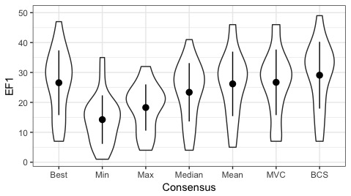
Virtual Screening Performance on 21 benchmark targets from DUD-E
Target Class | Target
GPCR | ADRB1
GPCR | DRD3
Ion Channel | GRIA2
Kinase | BRAF
Kinase | CDK2
Kinase | PLK1
Kinase | SRC
Miscellaneous | FABP4
Receptor | ESR1
Receptor | ESR2
Other Enzymes | ACE
Other Enzymes | GLCM
Other Enzymes | HDAC8
Other Enzymes | HIVINT
Other Enzymes | PDE5A
Other Enzymes | PTN1
Protease | ADA17
Protease | FA10
Protease | HIVPR
Protease | MMP13
Protease | TRY1
Consensus
EF1 is a standard VS metric. It is the fold-enrichment for actives observed in the top 1% scoring cpds from a docked chemical library. EF1 = 1 indicates no enrichment or random.
P < 0.05
Pairwise t-test
Ericksen et al., J. Chem. Inf. Model. 2017, 57, 7, 1579-1590 DOI: 10.1021/acs.jcim.7b00153

Slide 13
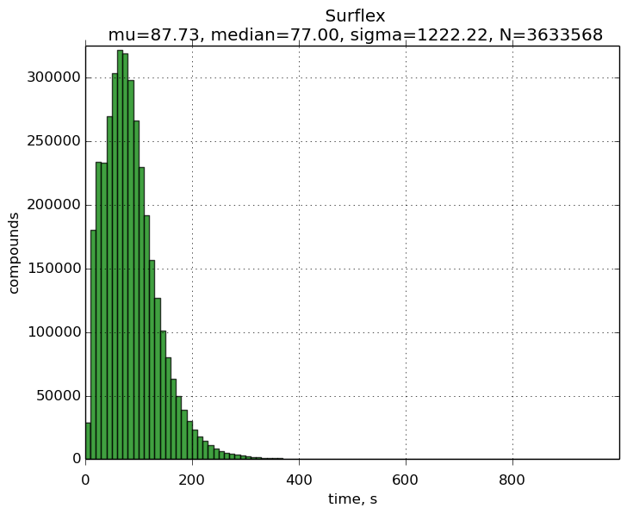
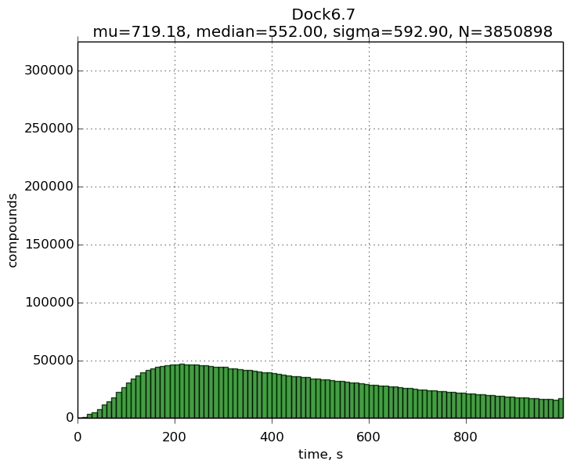
Docking Compute Expense
Compute time for docking depends the search space, search quality, and complexity of the scoring function.
To dock millions of compounds, we cut corners.
Docking time varies between programs (~1 minute/compound).
(seconds)
Program | Time | Std. Dev.
AD4 | 435.6 | 197.1
Dock | 719.2 | 592.9
Fred | 15.6 | 5.7
Hybrid | 9.3 | 2.9
Plants | 43.4 | 20.5
rDock | 49.3 | 26.7
Smina | 250.1 | 172.8
Surflex | 78.9 | 1159.6

Slide 14
How do we scale SBVS with HTC resources?
Each docking run is independent--pleasantly parallelizable!
Typical docking codes don’t benefit from specialized hardware or multiple cores.
Moved to docker containers for rDock and Gnina
To maximize throughput:
Enable “Flock” and “Glide” to access more nodes.
Split compound library up into small chunks.
Number of compounds should run in ~2hr for a given docking program.
Chunk size varies from 5—500 compounds!
Dock each chunk on a single slot to scavenge ANY open slots. Dock compounds in chunk serially.
Checkpointing is enabled and a wrapper script is used to track the compounds completed in case job is evicted and migrates to another node.
Notes:
+WantFlocking = true # enables other UW Pools
+WantGlidein = true # enables off campus OSG Pools

Slide 15
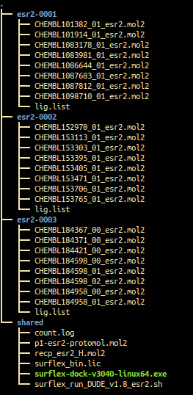
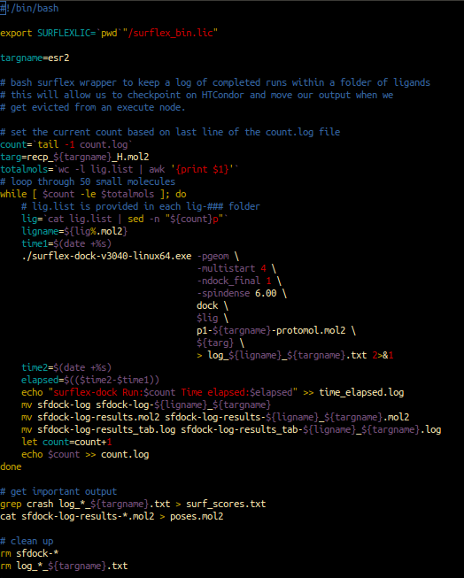

Slide 16
How does SBVS benefit from HTC?
Couldn’t really see how docking-based VS works without proper testing/validation!
Examine performance over many targets
Benchmarking of different docking programs
Extensive docking parameter testing/validation
Dock large compound sets
Routinely perform SBVS on libraries of 3-30 million cpds
Hypothetical 100 node cluster = 3.5 million/day
100s of millions to BILLIONS of dockings!
Notes:
Hypothetical cluster: 100 nodes * 2 sockets * 6 cores * 2 threads = 1600 slots = 3.5 million dockings per day
Local SMSF resources: 3 nodes * 2 sockets * 6 cores * 2 threads = 24 slots = 34,560 dockings per day

Slide 17
LBVS
ligand-based virtual screening

Slide 18
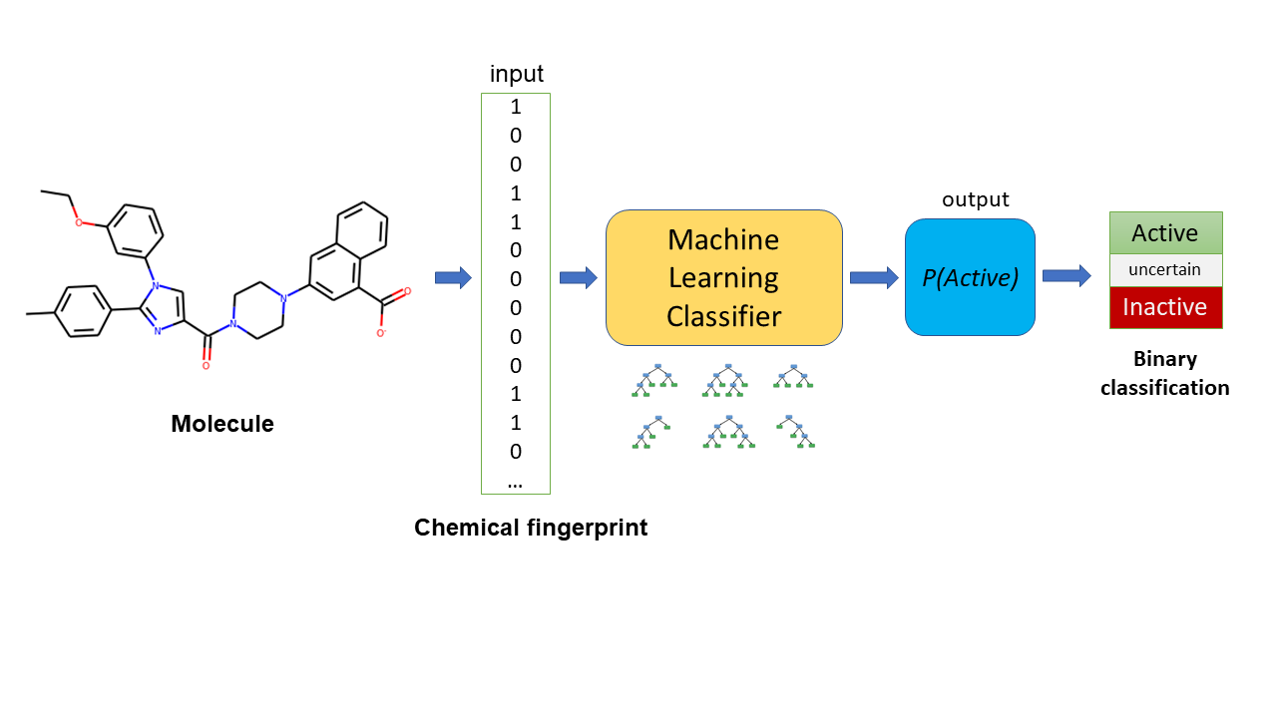
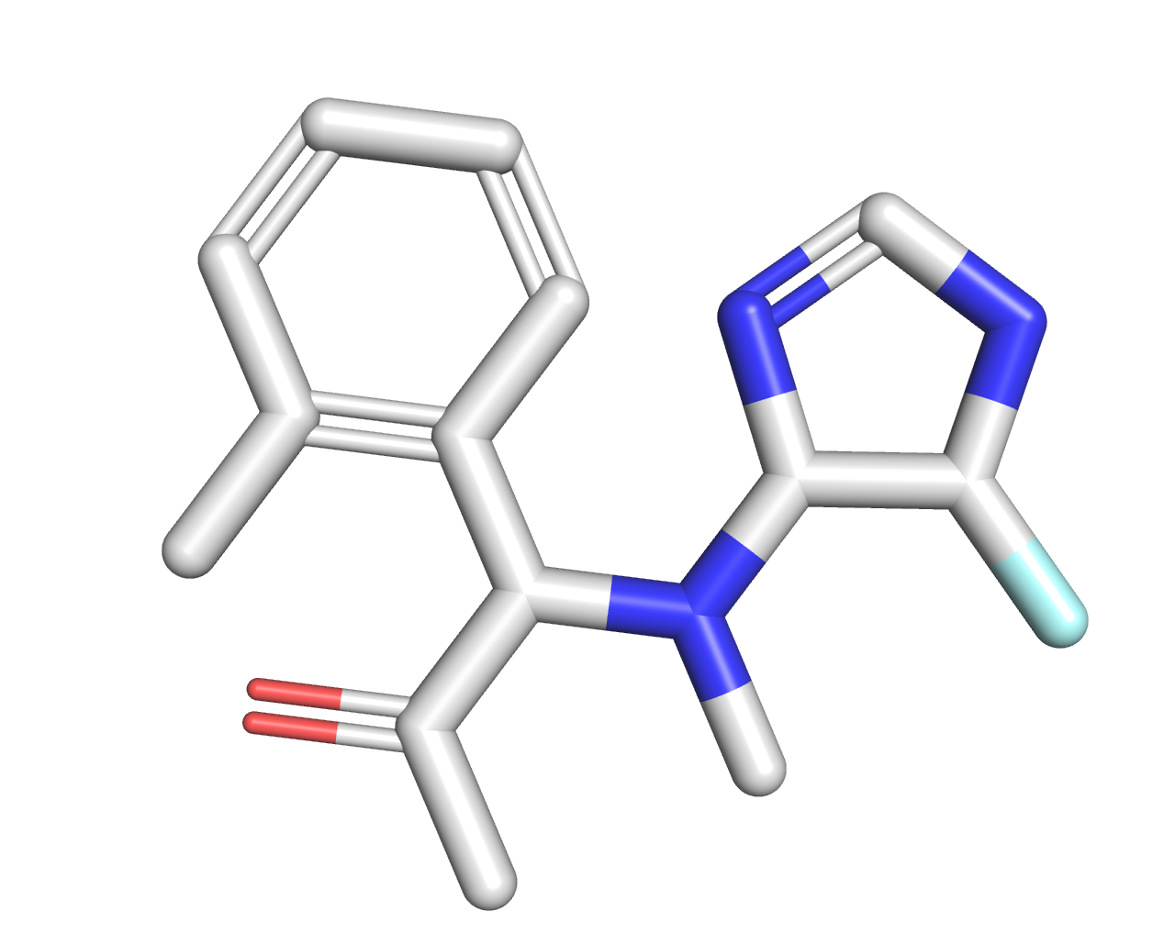
Ligand-Based Virtual Screening—a ML hit-finding model
C1=CC(=C(C=C1)C(C(C)=O)N(C)C2C(NC=N2)F)C
Chemical Fingerprint
Gitter Lab: Liu, et al., “Practical Model Selection for Prospective Virtual Screening.” J. Chem. Inf. Model. 2019, 59, 1, 282–293. https://doi.org/10.1021/acs.jcim.8b00363

Slide 19

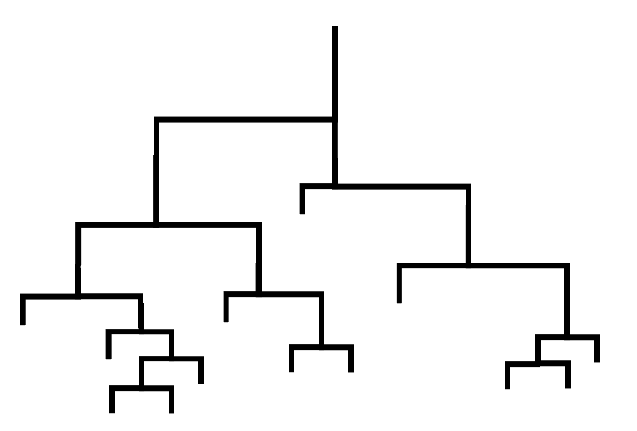

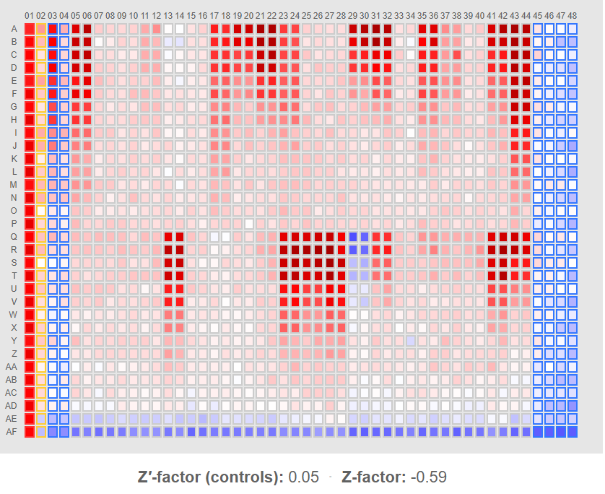
Machine Learning-Based Virtual Screen on Ultra-Large Chemical Library
Ultra-Large Virtual Chemical Library
Enamine REAL database
1.1 billion potential molecules
“synthesize-on-demand”
Random Forest Classifier
Acquire/Test Molecules Prioritized by Classifier
$$$
Prior HTS
Training Data
Alnammi M. et al., “Evaluating scalable supervised learning for synthesize-on-demand chemical libraries.” ChemRxiv 2021.

Slide 20
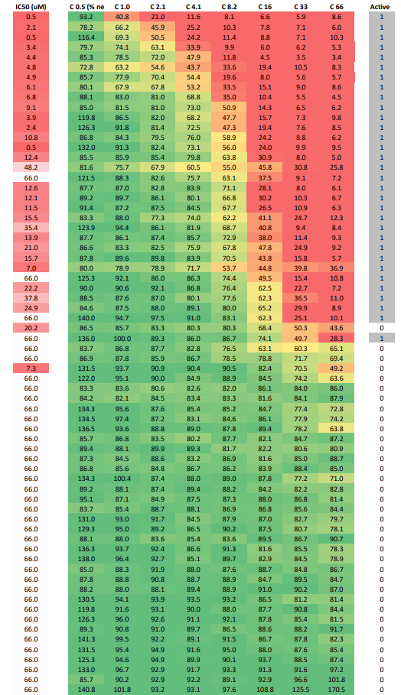
VS on Ultra-Large Virtual Chemical Library
Dose-response testing of 68 compounds ordered from Enamine
Train RF model on prior screening data (PriA-SSB interaction)
LifeChem Diversity Sets 1-3: 75,000 cpds (primary and retest)
LifeChem Diversity Set 4: 25,000 cpds (primary only)
MLPCN (NIH probe set): 337,000 cpds (primary and retest)
Training Data: 427,000 cpds, number of actives: 554 (hit rate = 0.13%)
VS Procedure
https://github.com/gitter-lab/pria-ams-enamine/tree/master
Download Enamine REAL database 1.1 billion molecules (Oct 11, 2019)
Split library up into 18 batches (each 60.3 million)
Average compute time of 3.24 ms per compound
Mean run time per 60 million cpd batch = 53.2 hrs
https://enamine.net/compound-collections/real-compounds/real-database
Gitter Lab: Alnammi M. et al., “Scalable supervised learning for synthesize-on-demand chemical libraries.” manuscript in prep

Slide 21
How do we run LBVS with HTC resources?
split very large library in chunks of SMILES (1 line → 1 compound), CSV file, a few million per chunk
/submit.sub
/run.sh
/chunk_1/chunk_1.smi
/chunk_2/chunk_2.smi
/chunk_3/chunk_3.smi
…
/shared/RF_model.pickle
/cheminf.yaml
/run_RF.py
submit file copies over a folder with chunk of SMILES and the contents of shared folder (.yaml for conda environment and ML classifier)
submit file runs executable (bash script)
BASH executable script (run.sh) downloads Anaconda (wget/curl) and runs Anaconda binary installer
BASH executable script runs conda install using .yaml file (cheminf.yaml) to setup python cheminformatics environment (scikit-learn and rdkit), activates environment
executable runs python script
python script uses rdkit module to convert SMILES to fingerprints (numpy array)
python script uses scikit-learn module to load random forest classifier and predict on fingerprints
return output CSV containing only molids and classification results
Notes:
Hypothetical cluster: 100 nodes * 2 sockets * 6 cores * 2 threads = 1600 slots = 3.5 million dockings per day
Local SMSF resources: 3 nodes * 2 sockets * 6 cores * 2 threads = 24 slots = 34,560 dockings per day

Slide 22
Conclusions
HTC is a fabulous resource for VS.
Effective VS requires rapid cycles of development, testing, validation. HTS enables this!
HTC allows VS to scale to new ultra-large virtual chemical libraries.

Slide 23

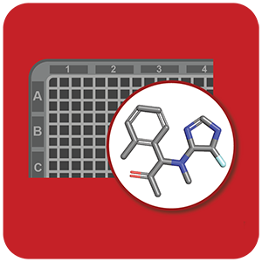





Acknowledgments
CHTC, CHTC Facilitators:
Miron Livny, Christina Koch, Lauren Michael, …
Funding
Tony Gitter & Michael Newton “A Machine Learning Platform for Adaptive Chemical Screening.” 1R01GM135631-01A1
Manish Patankar -- I01BX005627 (VA)
UWCCC Shared Resources -- P30 CA014520
Computational Chemists
Ken Satyshur, Scott Wildman, Shengchao Liu, Moayad Alnammi, Yifan Deng, Haozhen Wu, Huikun Zhang
DDC-SMSF
Notes:
Hypothetical cluster: 100 nodes * 2 sockets * 6 cores * 2 threads = 1600 slots = 3.5 million dockings per day
Local SMSF resources: 3 nodes * 2 sockets * 6 cores * 2 threads = 24 slots = 34,560 dockings per day

Slide 24
Appendix

Slide 25
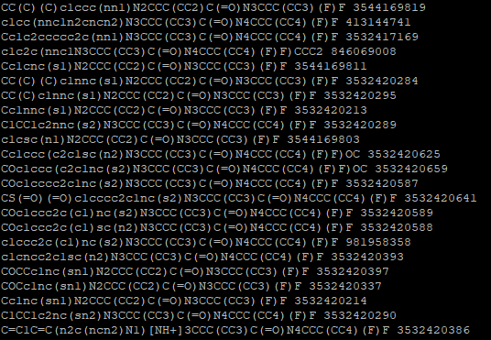
“chunk_1.smi” input data SMILES file
Notes:
Hypothetical cluster: 100 nodes * 2 sockets * 6 cores * 2 threads = 1600 slots = 3.5 million dockings per day
Local SMSF resources: 3 nodes * 2 sockets * 6 cores * 2 threads = 24 slots = 34,560 dockings per day

Slide 26
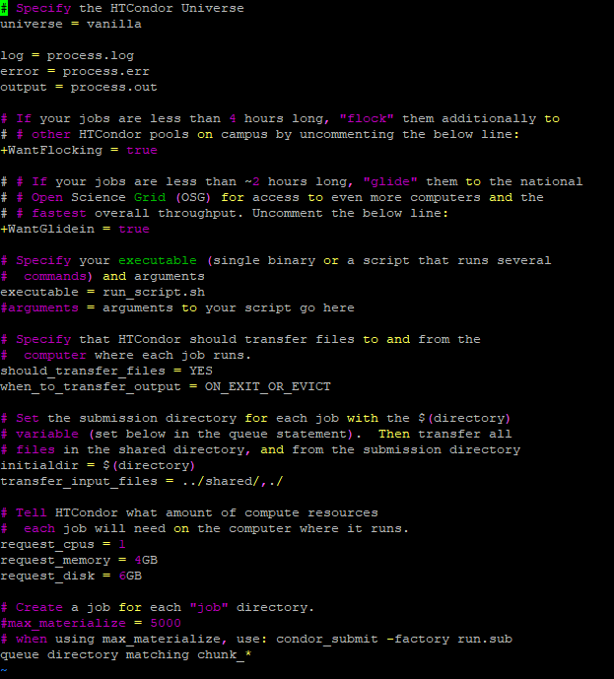
condor submit script “submit.sub”
Notes:
Hypothetical cluster: 100 nodes * 2 sockets * 6 cores * 2 threads = 1600 slots = 3.5 million dockings per day
Local SMSF resources: 3 nodes * 2 sockets * 6 cores * 2 threads = 24 slots = 34,560 dockings per day

Slide 27
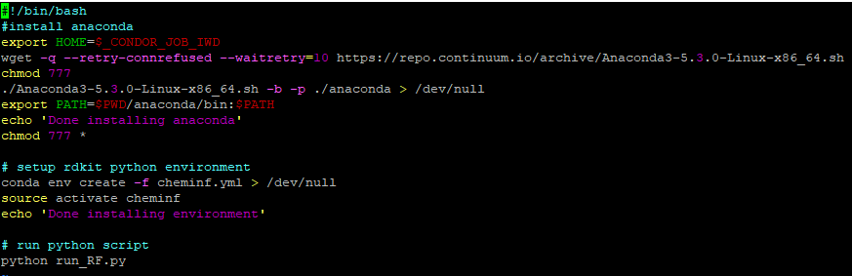
BASH executable script “run.sh”
Notes:
Hypothetical cluster: 100 nodes * 2 sockets * 6 cores * 2 threads = 1600 slots = 3.5 million dockings per day
Local SMSF resources: 3 nodes * 2 sockets * 6 cores * 2 threads = 24 slots = 34,560 dockings per day

Slide 28
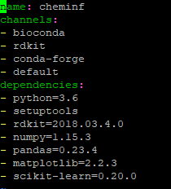
conda .yaml environment setup file “cheminf.yml”
Notes:
Example of conda .yml file for building a cheminformatics python environment

Slide 29
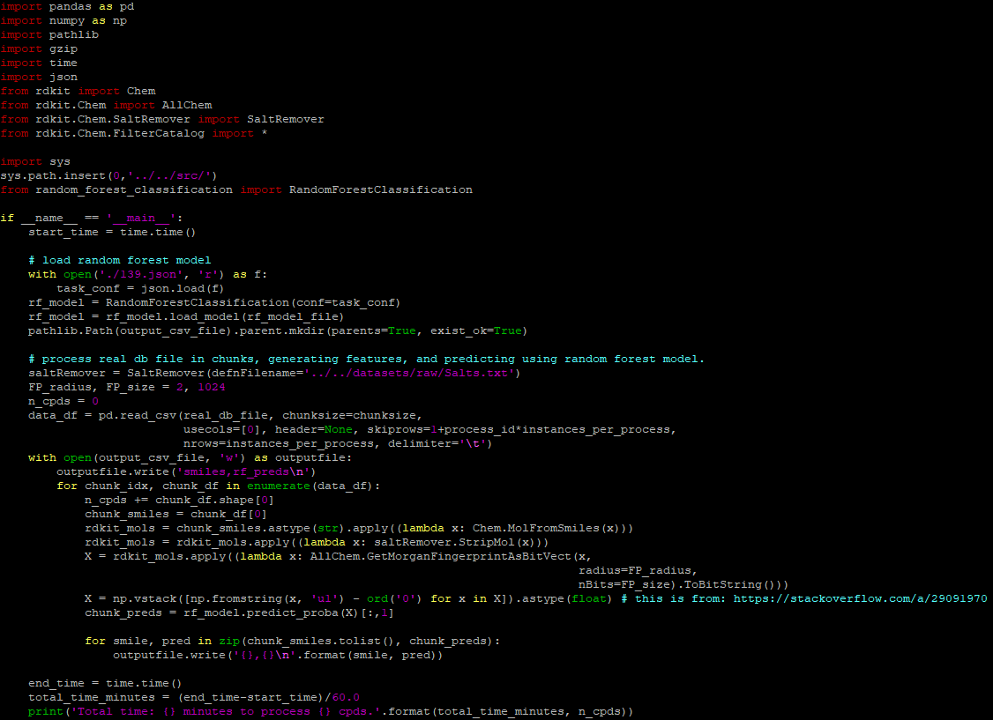
python executable script “run_RF.py”
Notes:
https://github.com/gitter-lab/pria-ams-enamine/blob/master/predict_REAL_db/RF_preds/predict_real_db.py

Slide 30
Contact me at SMSF ssericksen@wisc.edu
Do you study a protein involved in a disease?
Looking for molecules to modulate a protein’s function?
Need probes for studying your protein or mechanism?
Do you study a biological process or phenotype you want to perturb?
Do you have active compounds for your target but don’t know what to do next?
Would you like assistance interpreting HTS data and choosing the best active molecules to move forward?
Want analogs of known active compounds for your target protein?
Need help navigating the purchasable chemical space to acquire compounds for testing?
https://cancer.wisc.edu/research/resources/ddc/smsf/
Notes:
Assay costs: $0.10-$1.00 per well – average $0.40.
Compound costs: range: $10-$100 (non-bulk) and $1-$2 (bulk) – avg $30.00 compound (non-bulk)
Screen 10,000 -> $15k + $4k = $19k
Screen 50,000 -> $75k + $20k = $95k

Slide 31

Computational Services of the Drug Development Core
Hit Finding
Virtual Screening (VS)
Structure-Based (SBVS)
Ligand-Based (LBVS)
Public Data Mining for Target-Focused Libraries
Model-Guided Iterative Screening
Probe Set Selection
Hits Triage
HTS Data Analysis
Similarity Searches
Chemical Clustering
Property Prediction
Property Filters
Hit Expansion
Molecule Purchasing
Lead Optimization
ML-based QSAR
Molecular Dynamics and Binding Free Energy Calcs

Slide 32
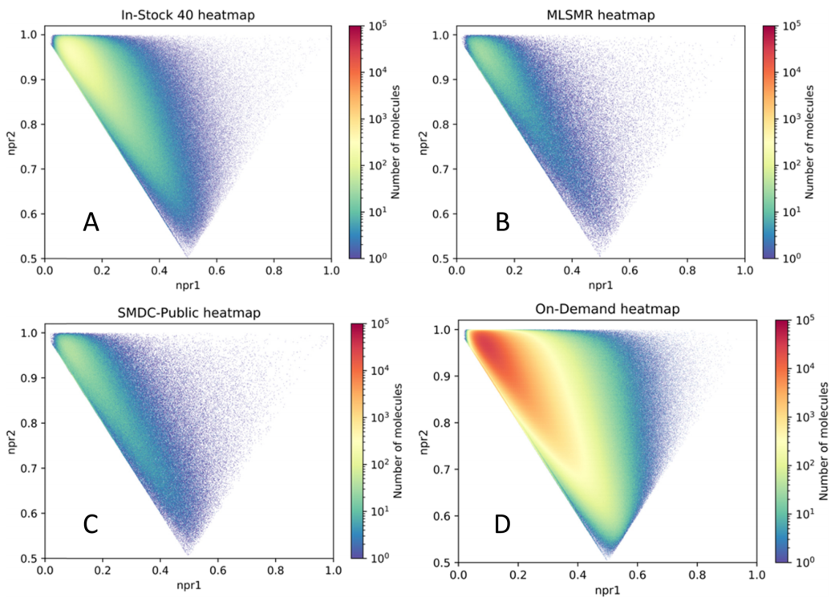
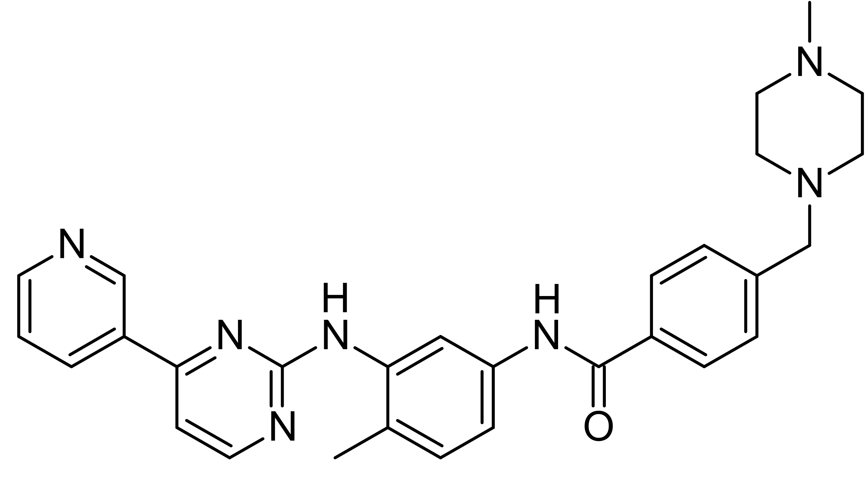
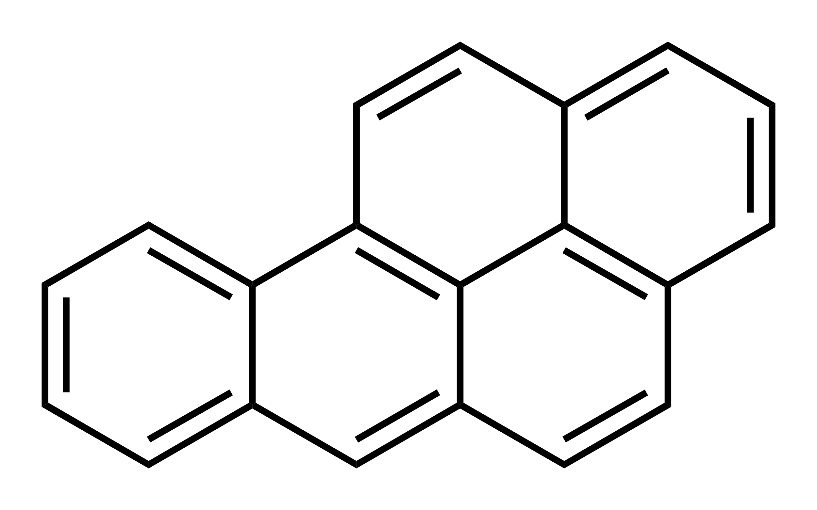
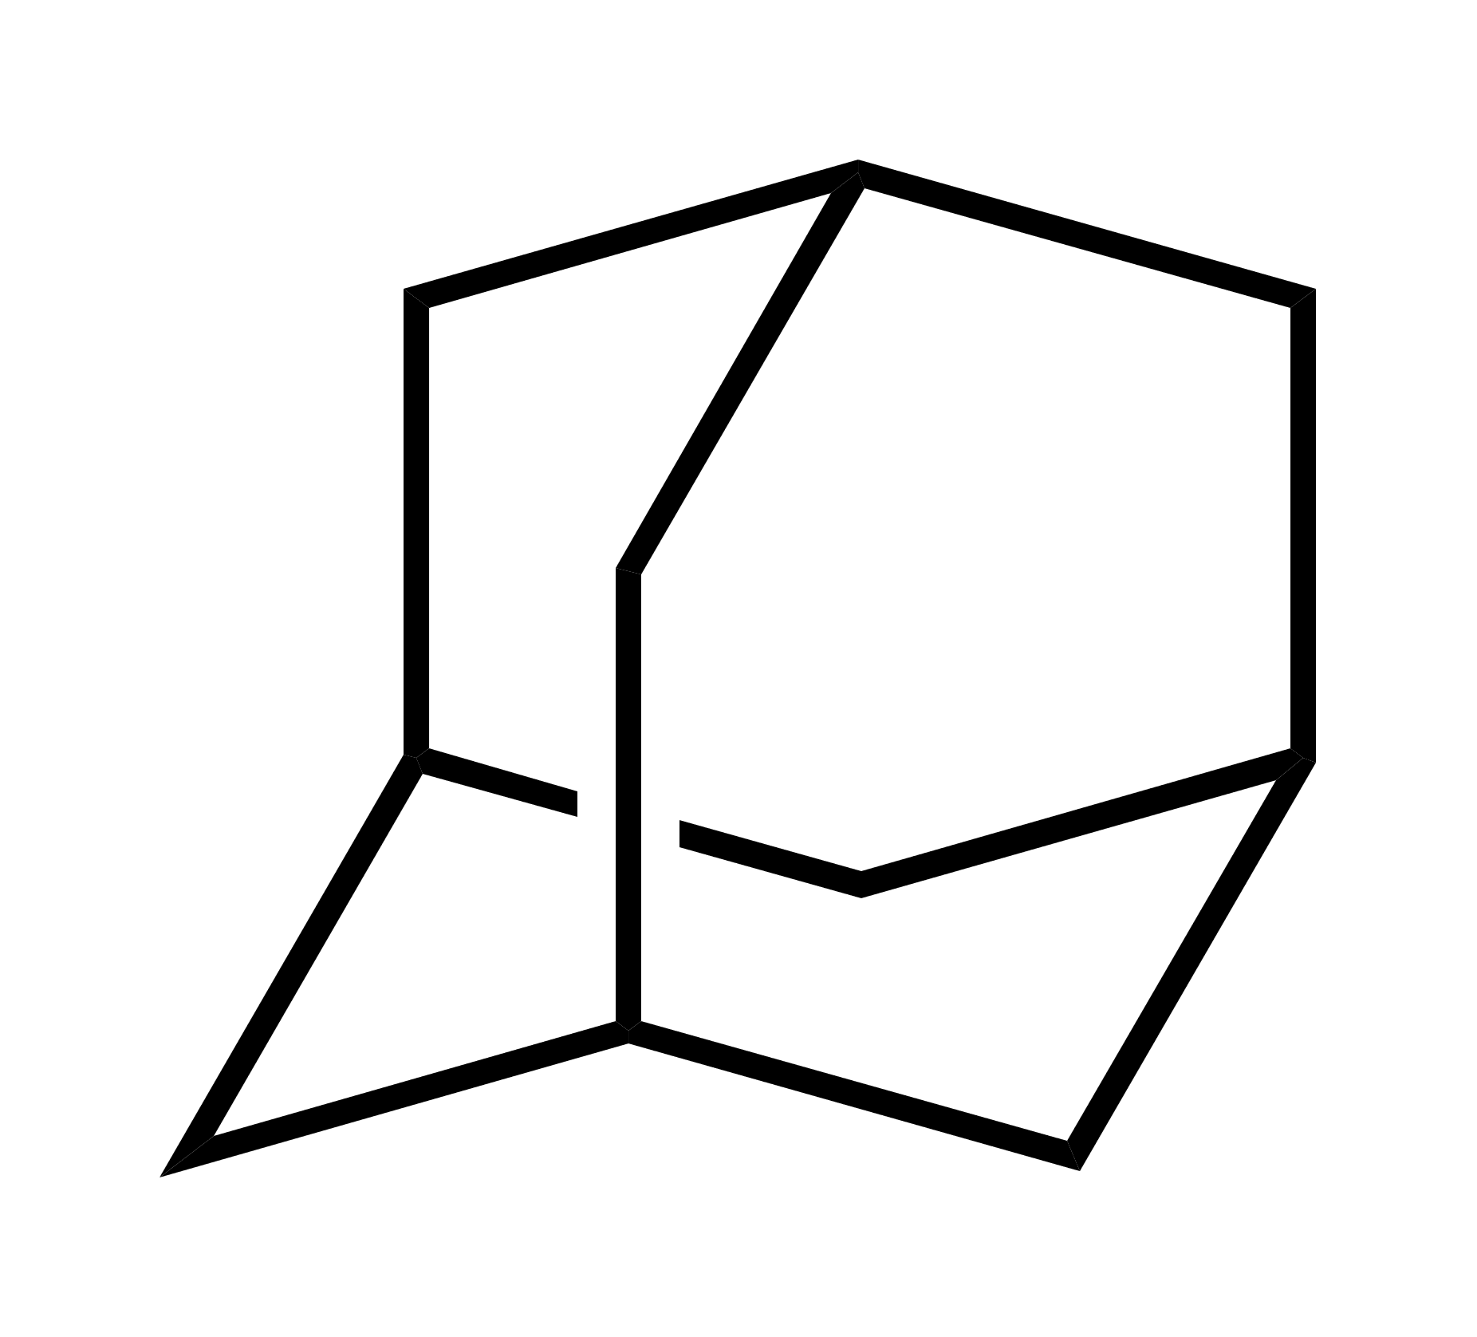
NPMI = normalized ratios of principle moments of inertia
6E6 cpds
4E5 cpds
rods
spheres
discs
rods
discs
7E5 cpds
5E8 cpds
spherical
Irwin JJ et al., “ZINC20—A Free Ultralarge-Scale Chemical Database for Ligand Discovery.” J. Chem. Inf. Model. 2020, 60, 6065-6075.

Slide 33
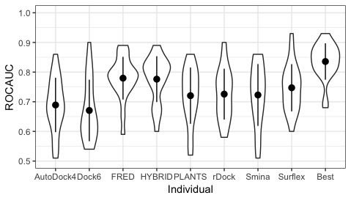
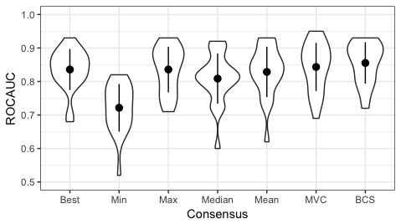
Target Class | Target
GPCR | ADRB1
GPCR | DRD3
Ion Channel | GRIA2
Kinase | BRAF
Kinase | CDK2
Kinase | PLK1
Kinase | SRC
Miscellaneous | FABP4
Receptor | ESR1
Receptor | ESR2
Other Enzymes | ACE
Other Enzymes | GLCM
Other Enzymes | HDAC8
Other Enzymes | HIVINT
Other Enzymes | PDE5A
Other Enzymes | PTN1
Protease | ADA17
Protease | FA10
Protease | HIVPR
Protease | MMP13
Protease | TRY1
Virtual screening performance on 21 benchmark targets
P > 0.05
Pairwise t-test
PI Mitchell (Gitter/Hoffmann co-Pis)
https://research.wisc.edu/funding/uw2020/round-3-projects/an-adaptive-computational-pipeline-drug-discovery/
Ericksen et al., J. Chem. Inf. Model. 2017, 57, 7, 1579-1590 DOI: 10.1021/acs.jcim.7b00153

Slide 34
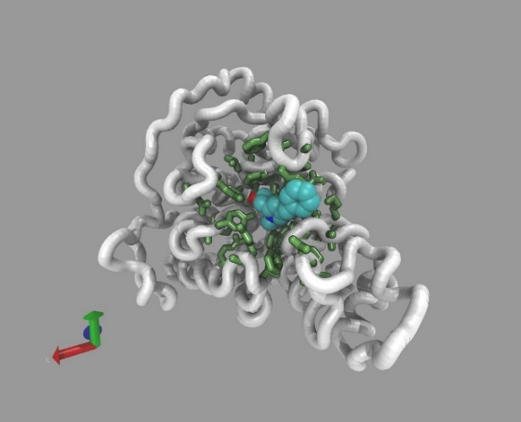
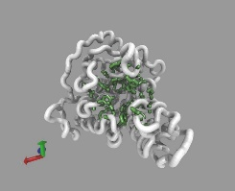
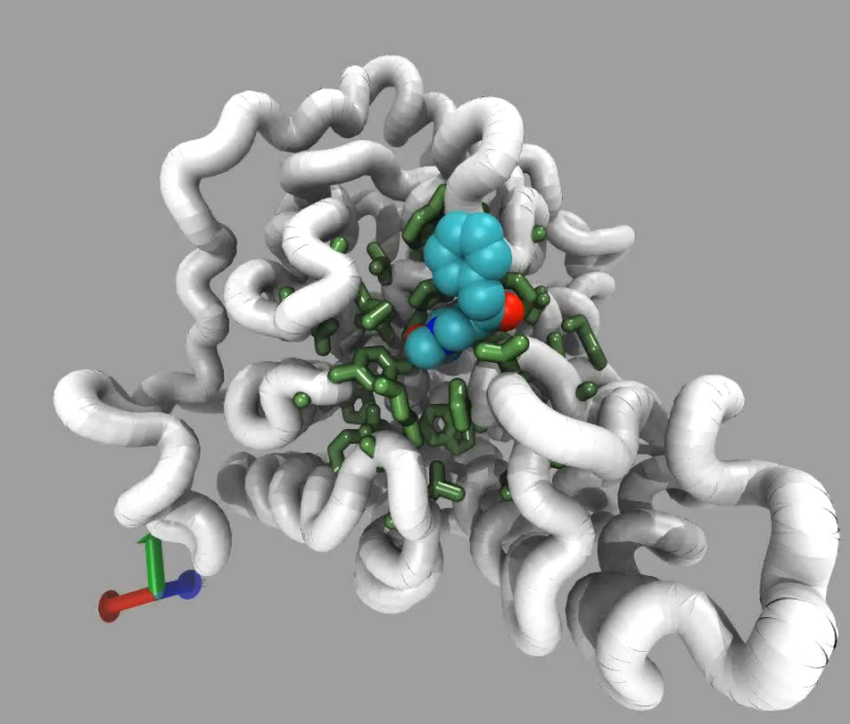
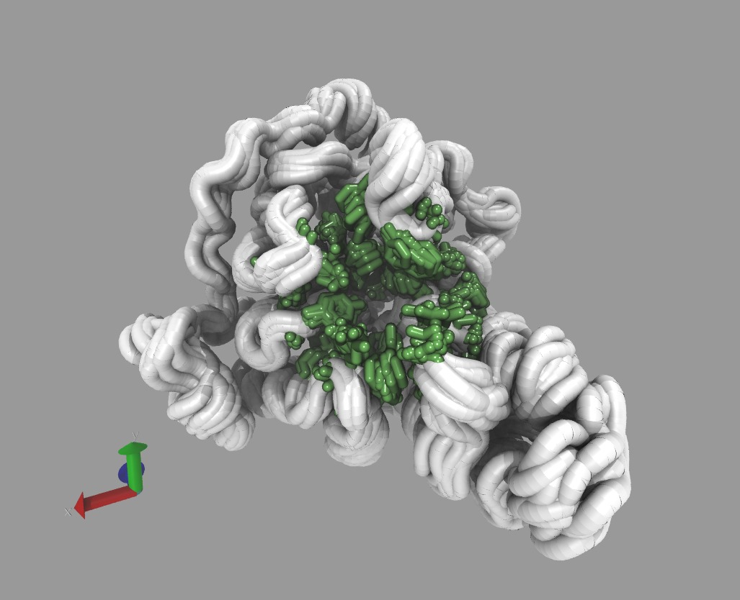
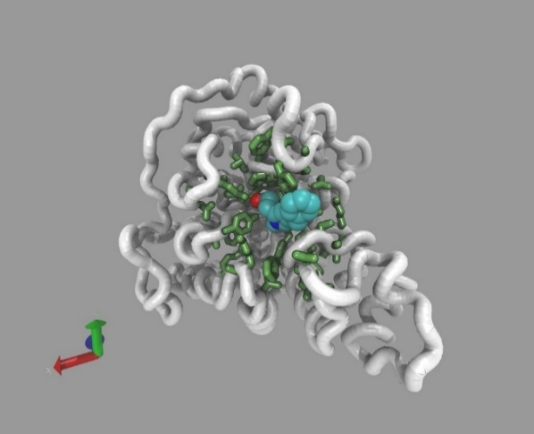
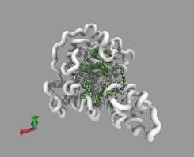
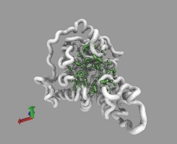
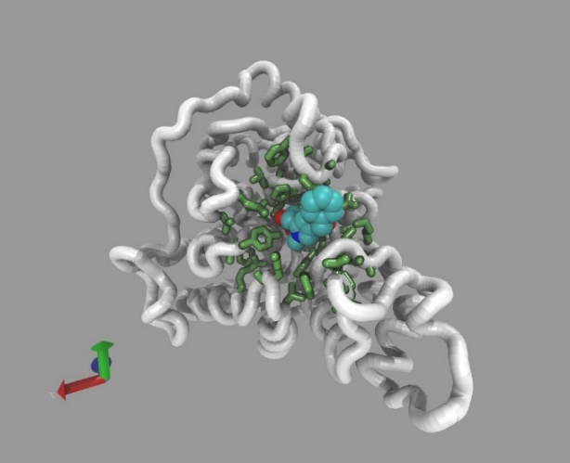
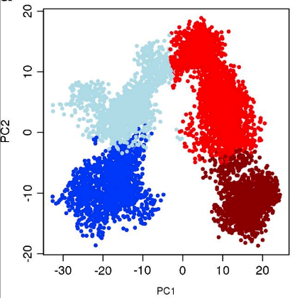
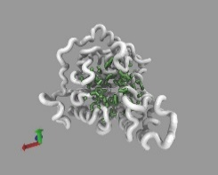

Ensemble Docking
Enumerate
Consensus
Scoring
Dock with Multiple Programs, Extract Features
Select

Slide 35

Ensemble Docking
hivint

Slide 36
Ligand-Based Virtual Screening—a ML hit-finding model
Model Uncertainty = 0.5 – abs[ P(Active) – 0.5 ]
Gitter Lab: Liu, et al., “Practical Model Selection for Prospective Virtual Screening.” J. Chem. Inf. Model. 2019, 59, 1, 282–293. https://doi.org/10.1021/acs.jcim.8b00363

Slide 37
Tiered approach for SBVS
Synthesized-on-demand virtual library
10 – 100 billion cpds (SMILES)
PROPERTY FILTER
1 – 10 billion cpds (SMILES)
ROCS
0.1 – 5 billion cpds (3D)
Fast Docking
5-200 million cpds
Consensus Docking
2-20k cpds
clustering
50-500 cpds
MD/ML-based affinity?
$$$

Slide 38
VS for ultra-large virtual libraries
LBVS with RF and fingerprints easily scales to 1.0 billion cpds
SBVS study required 5 million CPU hours to evaluate 1.3 billion cpds.
Gorgulla, C., et al., “An open-source drug discovery platform enables ultra-large virtual screens.” Nature 2020,580, 663–668.
Another SBVS used 27,612 GPUs to score 1.37 billion in < 24 hours.
Glaser, J., et al., “High-throughput virtual laboratory for drug discovery using massive datasets.” The International Journal of High Performance Computing Applications.
We have applied SBVS in consensus docking screens with 6 programs on libraries up to ~40 million cpds.

Slide 39
Abstract
Progress in chemical synthesis strategies has given rise to vast “make-on-demand” chemical libraries. Such libraries, now virtual, are bounded only by synthetic feasibility and grow exponentially. Making and testing significant portions of such libraries on a new drug target is not feasible. We increasingly rely on computational approaches called virtual screening methods to help us navigate large chemical spaces and to prioritize the most promising molecules for testing. The main challenge now is to scale existing virtual screening methods, or develop new ones, with sufficient molecule throughput and scoring accuracy to accommodate ultra-large compound libraries. Here I will describe some promising approaches that leverage high-throughput computing to meet this challenge.

Slide 40
What is virtual screening?
Drug Discovery: looking for needle in haystack: potentially 10³³ drug-like organic molecules* are theoretically possible—but only a some will be active against a disease state and also non-toxic
High Throughput Screening (HTS): Brute Force approach is to experimentally test 10,000s to millions molecules---expensive!
~$15-200 compound (to purchase them)
~$0.10-1.00 per experiment (to test them in automated, robotic HTS experiments)
Virtual Screening (VS): Filter very large molecule sets by computational techniques. Prioritize a subset for testing in a highly focused screen.
*Polishchuk PG, et al., JCAMD 2013 27(8):675-9
Notes:
Assay costs: $0.10-$1.00 per well – average $0.40.
Compound costs: range: $10-$100 (non-bulk) and $1-$2 (bulk) – avg $30.00 compound (non-bulk)
Screen 10,000 -> $15k + $4k = $19k
Screen 50,000 -> $75k + $20k = $95k

Slide 41

DUD-E: Benchmarking Data Set to Validate Docking-Based VS Methods
“A Database of Useful Decoys: Enhanced”
102 protein targets
22,886 active compounds with minimum potency 1 μM (or better)
100-600 ligands per target
~50 decoys for each active ligand (~2% actives)
Decoys property-matched but dissimilar 2-D topology.
Properties: MW, LogP, HBA, HBD, rotatable bonds, net charge
ECFP4, keep 25% most dissimilar
Actives are clustered. Diversity of actives is promoted by keeping max of 3 tightest binders in each cluster.
Mysinger et al., J. Med. Chem., 2012, Jul 5. doi 10.1021/jm300687e .

Slide 42
Docking programs have different search and scoring strategies
Docking
Scoring
No single program works for all targets
No way to decide a priori which program is best for a new target

Slide 43
Individual Docking Algorithms
Target Class | Target | AD42 | DOCK6 | FRED | HYBRID | PLANTS | rDock | Smina | Surflex |  | Best
GPCR | ADRB1 | 0.68 | 0.78 | 0.77 | 0.65 | 0.86 | 0.81 | 0.79 | 0.80 |  | 0.86
GPCR | DRD3 | 0.69 | 0.59 | 0.79 | 0.81 | 0.69 | 0.66 | 0.68 | 0.71 |  | 0.81
Ion Channel | GRIA2 | 0.73 | 0.60 | 0.79 | 0.77 | 0.73 | 0.77 | 0.75 | 0.77 |  | 0.79
Kinase | BRAF | 0.73 | 0.60 | 0.75 | 0.69 | 0.54 | 0.79 | 0.86 | 0.71 |  | 0.86
Kinase | CDK2 | 0.76 | 0.61 | 0.81 | 0.85 | 0.68 | 0.74 | 0.71 | 0.69 |  | 0.85
Kinase | PLK1 | 0.60 | 0.48 | 0.80 | 0.75 | 0.65 | 0.68 | 0.57 | 0.60 |  | 0.80
Kinase | SRC | 0.65 | 0.64 | 0.65 | 0.66 | 0.52 | 0.68 | 0.67 | 0.66 |  | 0.68
Miscellaneous | FABP4 | 0.67 | 0.54 | 0.84 | 0.82 | 0.74 | 0.60 | 0.77 | 0.79 |  | 0.84
Receptor | ESR1 | 0.82 | 0.54 | 0.88 | 0.81 | 0.77 | 0.87 | 0.86 | 0.74 |  | 0.88
Receptor | ESR2 | 0.77 | 0.48 | 0.89 | 0.89 | 0.69 | 0.80 | 0.79 | 0.68 |  | 0.89
Other Enzymes | ACE | 0.78 | 0.72 | 0.80 | 0.84 | 0.84 | 0.62 | 0.61 | 0.76 |  | 0.84
Other Enzymes | GLCM | 0.55 | 0.60 | 0.70 | 0.81 | 0.64 | 0.77 | 0.51 | 0.79 |  | 0.81
Other Enzymes | HDAC8 | 0.70 | 0.90 | 0.87 | 0.76 | 0.82 | 0.71 | 0.86 | 0.83 |  | 0.90
Other Enzymes | HIVINT | 0.54 | 0.65 | 0.74 | 0.60 | 0.76 | 0.67 | 0.81 | 0.66 |  | 0.81
Other Enzymes | PDE5A | 0.68 | 0.65 | 0.84 | 0.82 | 0.79 | 0.78 | 0.74 | 0.66 |  | 0.84
Other Enzymes | PTN1 | 0.66 | 0.76 | 0.76 | 0.78 | 0.72 | 0.76 | 0.66 | 0.88 |  | 0.88
Protease | ADA17 | 0.51 | 0.40 | 0.59 | 0.69 | 0.58 | 0.58 | 0.54 | 0.70 |  | 0.70
Protease | FA10 | 0.86 | 0.81 | 0.79 | 0.82 | 0.80 | 0.90 | 0.84 | 0.76 |  | 0.90
Protease | HIVPR | 0.63 | 0.66 | 0.74 | 0.78 | 0.79 | 0.64 | 0.74 | 0.81 |  | 0.81
Protease | MMP13 | 0.67 | 0.60 | 0.77 | 0.87 | 0.71 | 0.67 | 0.67 | 0.76 |  | 0.87
Protease | TRY1 | 0.79 | 0.82 | 0.80 | 0.83 | 0.81 | 0.74 | 0.75 | 0.93 |  | 0.93
 | mean | 0.69 | 0.64 | 0.78 | 0.78 | 0.72 | 0.73 | 0.72 | 0.75 |  | 0.84
 | std. dev. | 0.09 | 0.12 | 0.07 | 0.08 | 0.10 | 0.09 | 0.10 | 0.08 |  | 0.06

Slide 44
Score distribution of actives (red) is shifted relative to inactives (blue).
Interestingly, the standard deviation in scores was also higher for actives than for decoys
Ericksen et al., J. Chem. Inf. Model. 2017, 57, 7, 1579-1590 DOI: 10.1021/acs.jcim.7b00153

Slide 45


HDAC8 benchmark
smina
consensus

Slide 46

Scaffold diversity “in-stock” vs. “on-demand”
5E8
5E5
6E6
4E5
Irwin JJ et al., “ZINC20—A Free Ultralarge-Scale Chemical Database for Ligand Discovery.” J. Chem. Inf. Model. 2020, 60, 6065-6075.

Slide 47
LBVS on Ultra-Large Virtual Chemical Library
After scoring, request pricing info on top 10,000 ranked cpds
Reduce list to 5620 cpds based on availability
Clustered the 100,000 LifeChem, 1024 cpds from AMS, and 5620 Enamine REAL cpds.
Use clusters to select a final list for purchase—predicted to be highly active, chemically diverse, chemically dissimilar from known actives in training set. Keep only Enamine clusters that did not contain an active cpds from training set or AMS set. (5620→2679 cpds)
Run the following PAINS (RDKit), Inpharmatic, and Lipinski filters (2679→1604)
Retain only cpds with >= 0.35 Tanimoto distance from closest training active (and AMS active) (1604 → 1354 cpds).
Take best scoring rep from remaining clusters (1354→311 cpds)
Select 100 diverse cpds from 311 using iterative Tanmioto distance selection. 1st selection as one with highest score. Second selection is the most distant from first. Continue selections of cpds most distant from the prior selections (mean or sum).
Update quote for these 100, 90 are still available with pricing info. Other 10 required custom chemistry ($$$ and longer time)
Ordered 90, synthesis failed on 22. Tested the 68 delivered in dose-response using 8 concentrations (in quadruplicate).
31 of 68 cpds tested were hits! (45.6% hit rate)
Gitter Lab: Alnammi M. et al., “Scalable supervised learning for synthesize-on-demand chemical libraries.” manuscript in prep

Slide 48
How do we scale LBVS to HTC resources?
Each RF-based compound evaluation is independent--pleasantly parallelizable!
Evaluation with pre-trained RF doesn’t benefit from specialized hardware or multiple cores.
To maximize throughput:
Split compound library up into chunks.
Each chunk should run in ~2hr (to efficiently use OSG/off-campus resources).
We split 1,077,562,987 cpds into 18 chunks of ~60 million (mean runtime=53.2 hrs, stdev=6.4 hrs)
Dock each chunk on a single slot to scavenge ANY open slots. Dock compounds in chunk serially.
Checkpointing is enabled and a wrapper script is used to track the compounds completed in case job is evicted and migrates to another node.
Notes:
+WantFlocking = true # enables other UW Pools
+WantGlidein = true # enables off campus OSG Pools

Slide 49

Ligand-Based VS—a ML hit-finding model
Recently applied on Jim Keck’s PriA-SSB target:
AMS library (8 million),
Purchased/tested 701, observed 337 hits
Enamine REAL database (1.1 billion cpds) Purchased/tested 68, observed 31 hits
Liu, et al., “Practical Model Selection for Prospective Virtual Screening.” J. Chem. Inf. Model. 2019, 59, 1, 282–293. https://doi.org/10.1021/acs.jcim.8b00363

